Slide 1

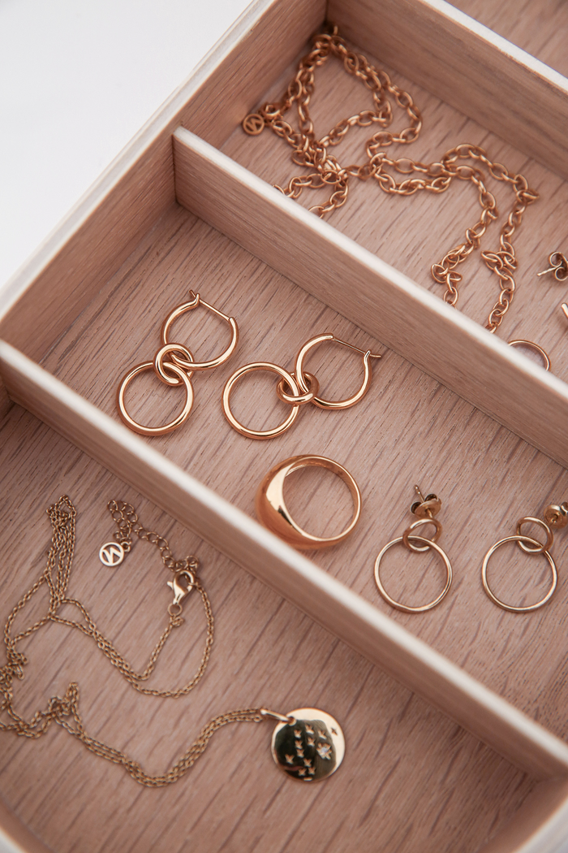
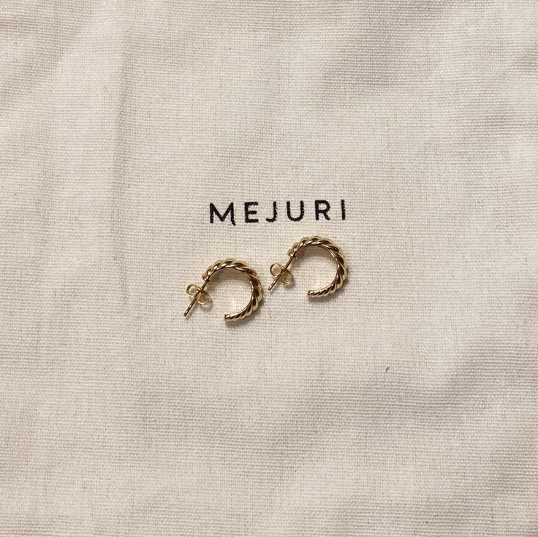
SEGMENTATION ANALYSIS FOR MEJURI - JEWELLERY BRAND
GROUP 3
SOUNDARYA CHANDRA MOHAN
GARIMA VIJAY
JAGTESHWAR SINGH BEDI
HARSHINI SHAIK

Slide 2
INTRODUCTION
INTRODUCTION:
MEJURI IS REVOLUTIONIZING ONLINE JEWELRY SHOPPING BY PRIORITIZING CUSTOMER PREFERENCES, OFFERING AFFORDABLE LUXURY, AND FOCUSING ON CUSTOMIZATION AND SUSTAINABILITY. BUILDING ON INITIAL SEGMENTATION ANALYSIS, DISCRIMINANT ANALYSIS HAS FURTHER REFINED OUR UNDERSTANDING OF CUSTOMER SEGMENTS, UNCOVERING DEEPER INSIGHTS INTO PREFERENCES, BUYING BEHAVIORS, AND DEMOGRAPHICS.

Slide 3
PROBLEM STATEMENT
PROBLEM STATEMENT
Discriminant ANALYSIS HELPS MEJURI SHARPEN ITS STRATEGIES BY IDENTIFYING NUANCED DISTINCTIONS AMONG CUSTOMER SEGMENTS. THESE INSIGHTS ENABLE MEJURI TO OPTIMIZE PRODUCT OFFERINGS, PRICING STRATEGIES, AND MARKETING INITIATIVES, ENSURING A PERSONALIZED AND IMPACTFUL CUSTOMER EXPERIENCE.
METHOD:
Questionnaires and Survey
The survey will gather insights into:
1. User preferences for jewelry style, materials, and purchase motivations.
2. Buying behaviors such as frequency, occasions, and price sensitivity.
3. Demographic and psychographic characteristics to uncover trends among customer segments.

Slide 4

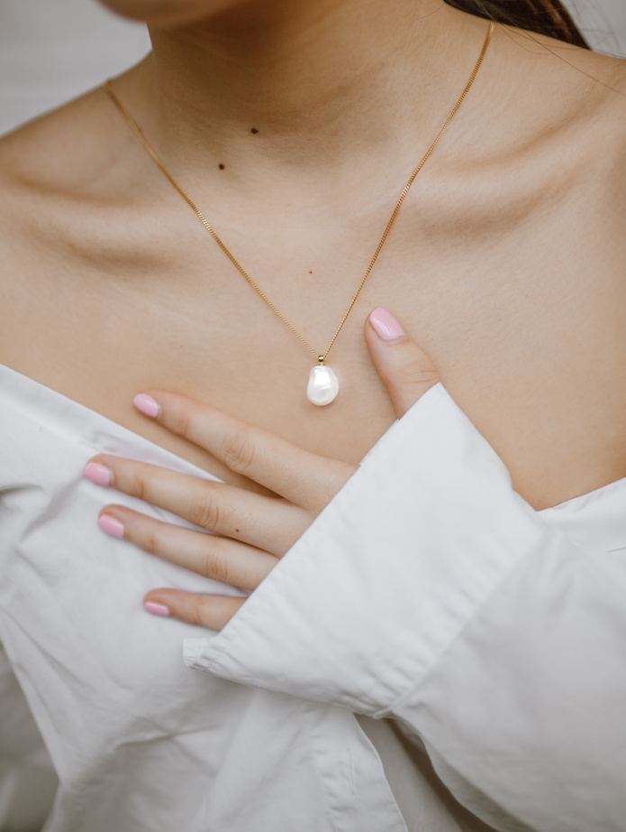
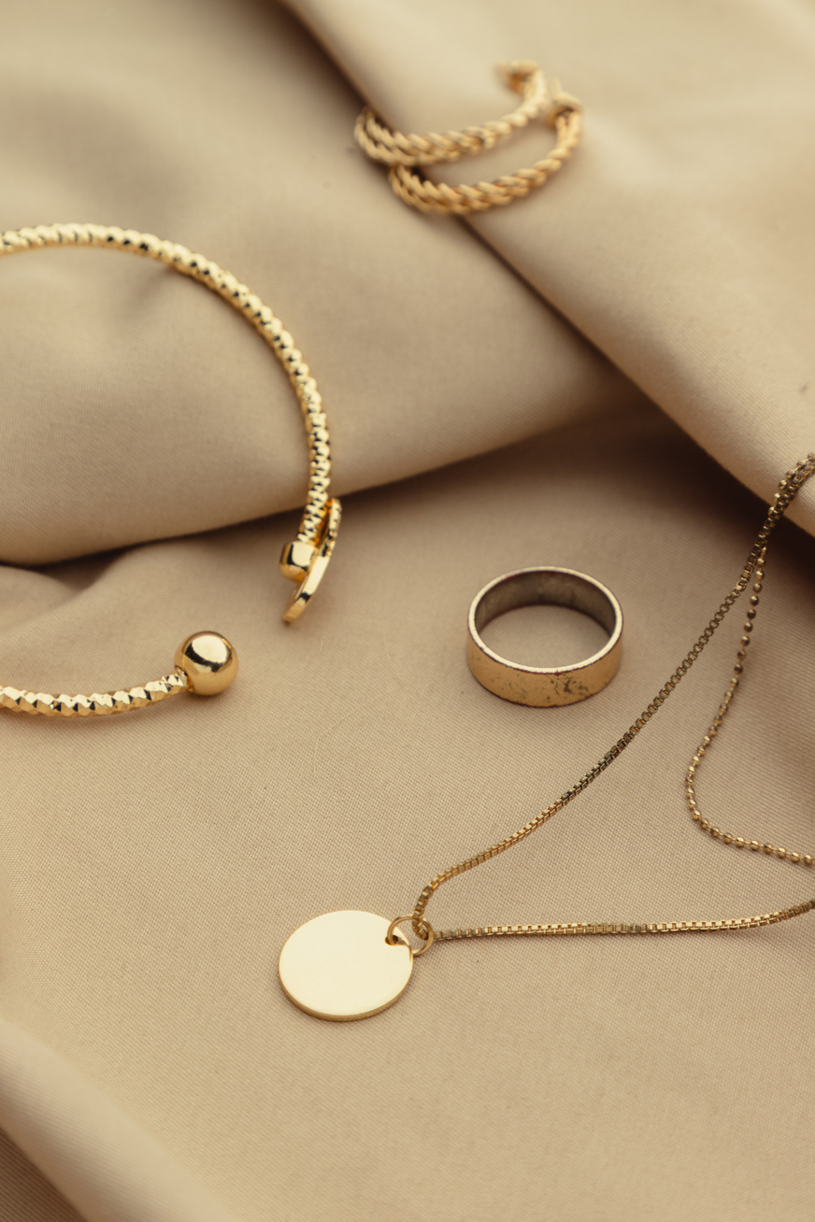
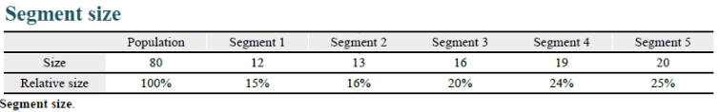
SEGMENTATION AND FINDINGS
Segments: The number of segments identified in the market is five distinct customer segments, which represents a statistical fit meeting the statistical criteria exclusively.

Slide 5
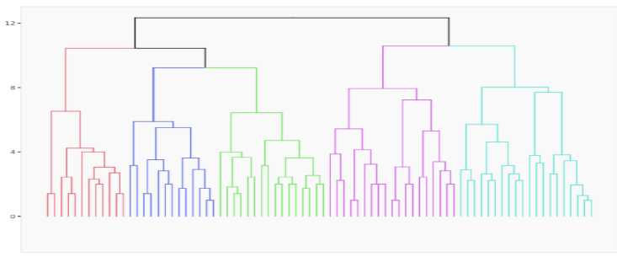
SEGMENTATION ANALYSIS(5-CLUSTER SOLUTION)

Slide 6
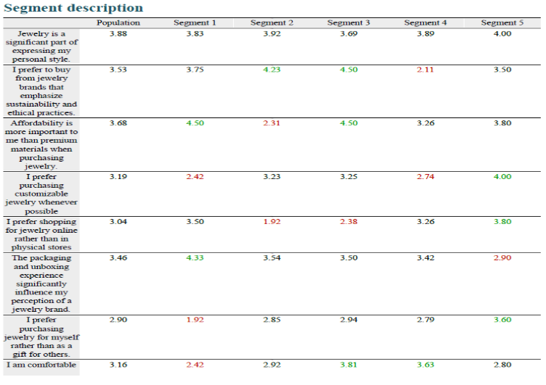
SEGMENTATION ANALYSIS(5-CLUSTER SOLUTION)

Slide 7
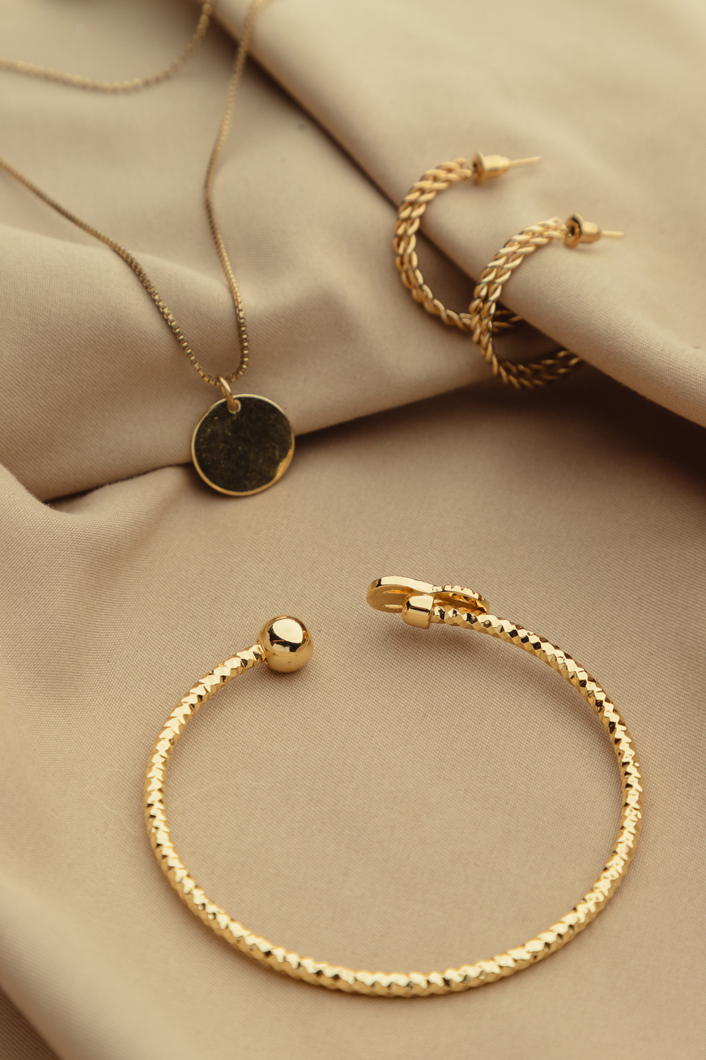
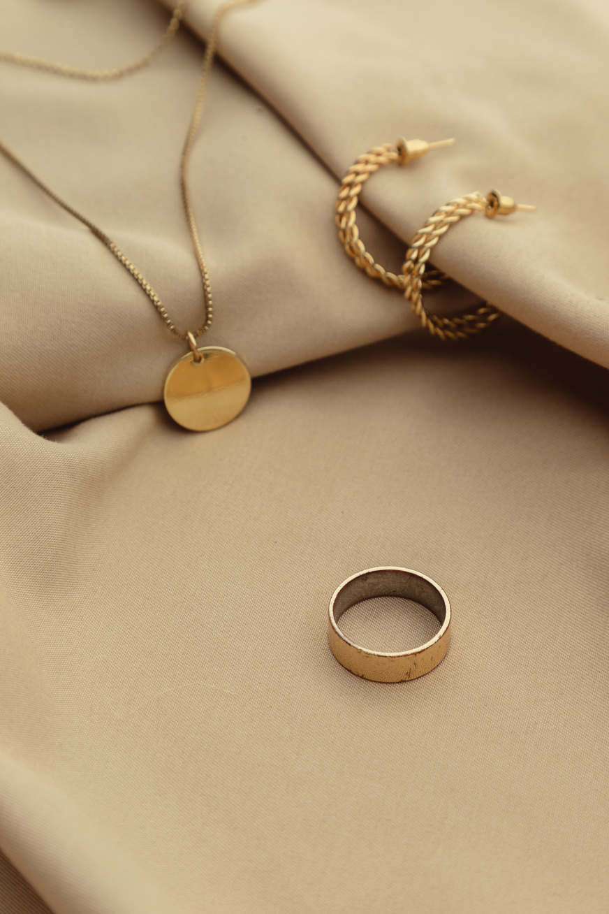
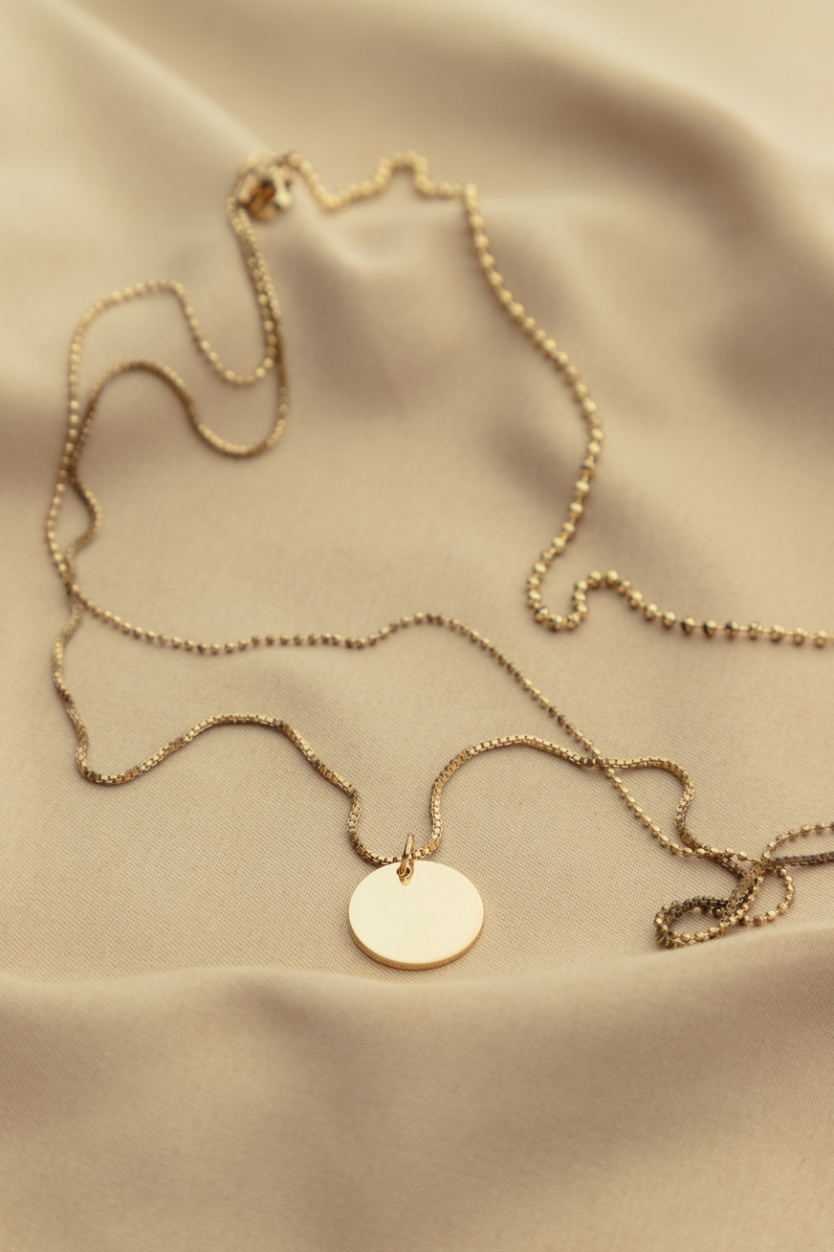
STATISTICAL ANALYSIS OF 5 SEGMENTS
Segment 1 (15%): Sustainability Prospects
Higher preference for affordability and sustainability.
Similar foremost interest is shown over packaging and customizable jewelry.
Segment 2 (16%): Price sensitive Buyers
Sustainability dominates customer preferences.
Least interest is projected for online shopping online for premium prices.
Segment 3 (20%): Budget-Savvy Shoppers
Affordability and sustainable items accepted at higher range over premium price items.
Less interest is shown while shopping online and various other packaging experiences.

Slide 8
STATISTICAL ANALYSIS OF 5 SEGMENTS
Segment 4 (24%): Comfort Seekers
A Stronger level of pitching is shown in comfort than any other likings .
A Low level of interest is shown in sustainability than customized jewels
.
Segment 5 (25%): Customization Lovers
High preference for customizable and online jewelry.
Moderate interest towards sustainability and affordability.

Slide 9
TARGETED CUSTOMER SEGMENTS
Segments 2, 3, and 5 are ideal for targeted marketing:
Segment 2: Sustainability-Focused Buyers
High preference for eco-friendly products and ethical practices.
Segment 3: Budget-Savvy Shoppers
Prioritize affordability and value-for-money offers.
Segment 5: Customization Lovers
Seek personalized jewelry and self-purchase options.

Slide 10
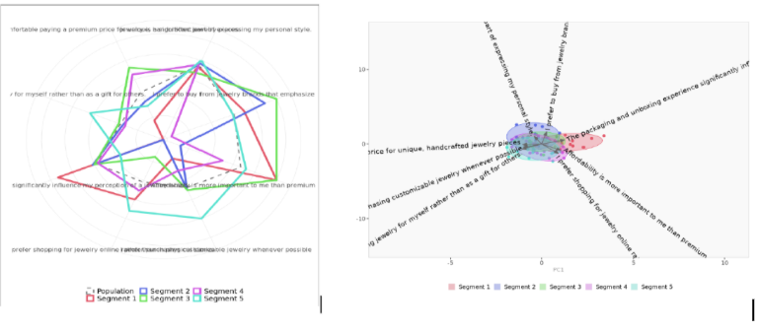
TARGETED SEGMENTS - VISUALIZATION
Segmentation Space: PCA-based clusters reveal overlaps due to excluded higher-dimensional differences, capturing 35.3% variance.
Spider Chart: Distinct preferences in Segments 2, 3, and 5 highlight opportunities in sustainability, affordability, and customization.

Slide 11
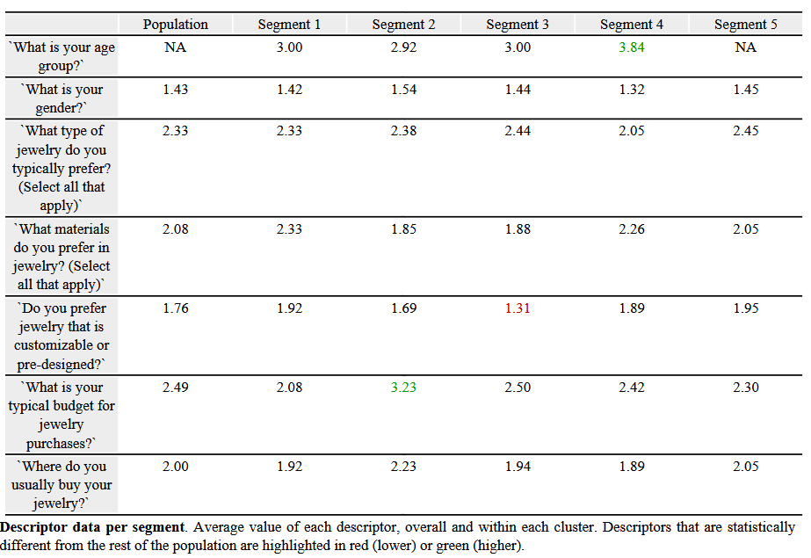
Discriminant Analysis

Slide 12
Discriminant Analysis
Segment 1:
Young Adults with a Preference for Silver Jewelry
• Age Group: Predominantly 25–34 years old (~3)
• Gender: Almost equally distributed (~1.42)
• Jewelry Type Preference: Necklaces and rings (~2.33)
• Material Preference: Strong preference for silver (~2.33)
• Customizability: Some preference (~1.92)
• Budget: Budget-conscious (~2.08)
• Purchasing Location: Brick-and-mortar stores (~1.92)

Slide 13
Discriminant Analysis
Segment 1:
Young Adults with a Preference for Silver Jewelry
• Age Group: Predominantly 25–34 years old (~3)
• Gender: Almost equally distributed (~1.42)
• Jewelry Type Preference: Necklaces and rings (~2.33)
• Material Preference: Strong preference for silver (~2.33)
• Customizability: Some preference (~1.92)
• Budget: Budget-conscious (~2.08)
• Purchasing Location: Brick-and-mortar stores (~1.92)

Slide 14
Discriminant Analysis
Segment 2:
Adults Seeking Luxury
and Customization
• Age Group: Majority are 35–44 years old (~3)
• Gender: Slightly more female (~1.54)
• Jewelry Type Preference: Necklaces and bracelets (~2.38)
• Material Preference: Prefer gemstones (~1.85)
• Customizability: Lean towards customizable jewelry (~1.69)
• Budget: $100–300 (~3.23)
• Purchasing Location: Favor online shopping (~2.23)

Slide 15
Discriminant Analysis
Segment 3:
Balanced Shoppers
• Age Group: Primarily 25–34 years old (~3)
• Gender: Slight male majority (~1.44)
• Jewelry Type Preference: Earrings and necklaces (~2.44)
• Material Preference: Favor gemstones (~1.88)
• Customizability: Neutral about customizability (~1.69)
• Budget: Comfortable with $100–300 (~2.50)
• Purchasing Location: Favor online and marketplaces (~1.94)

Slide 16
Discriminant Analysis
Segment 4:
Mature Buyers Focused
on Classic Jewelry
• Age Group: Majority are aged 55+ (~3.84)
• Gender: Slightly more male (~1.32)
• Jewelry Type Preference: Bracelets and rings (~2.05)
• Material Preference: Prefer gold and platinum (~2.26)
• Customizability: Neutral to pre-designed jewelry (~1.31)
• Budget: Spend moderately (~2.42)
• Purchasing Location: Prefer physical stores (~1.89)

Slide 17
Discriminant Analysis
Segment 5:
Younger Audience with
a Focus on Trends
• Age Group: Majority are aged 18–24 years (~3)
• Gender: More female participants (~1.45)
• Jewelry Type Preference: Necklaces and rings (~2.45)
• Material Preference: Favor gemstones and silver (~2.05)
• Customizability: Lean towards customizable jewelry (~1.95)
• Budget: Budget-conscious (~2.30)
• Purchasing Location: Prefer marketplaces and online platforms (~2.05)

Slide 18
THANK YOU

